Slide 1
CECS 326 Operating Systems
Virtual Memory
(Chapter 9, Operating system Concepts by Silberschatz, Galvin and Gagne)

Slide 2
Background
Code needs to be in memory to execute, but entire program rarely used
E.g., error code, unusual routines, large data structures
Entire program code not needed at same time
Consider ability to execute partially-loaded program
Program no longer constrained by limits of physical memory
Each program takes less memory while running ⇒ more programs run at the same time
Increased CPU utilization and throughput with no increase in response time or turnaround time
Less I/O needed to load or swap programs into memory -> each user program runs faster

Slide 3
Background (cont.)
Virtual memory – separation of user logical memory from physical memory
Only part of the program needs to be in memory for execution
Logical address space can therefore be much larger than physical address space
Allows address spaces to be shared by several processes
Allows for more efficient process creation
More programs running concurrently
Less I/O needed to load or swap processes
Virtual address space – logical view of how a process is stored in memory
Usually start at address 0, contiguous addresses until end of space
Meanwhile, physical memory organized in page frames (aka memory blocks)
Up to memory management unit (MMU) to map logical to physical
Virtual memory can be implemented via:
Demand paging
Demand segmentation

Slide 4
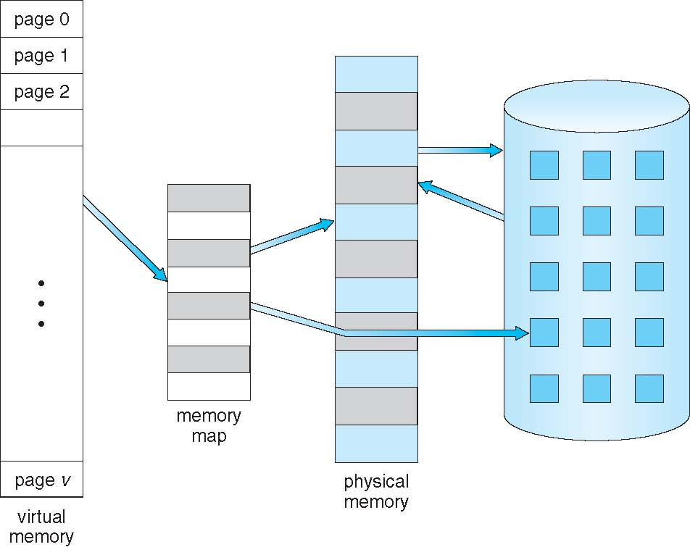
Virtual Memory vs Physical Memory

Slide 5
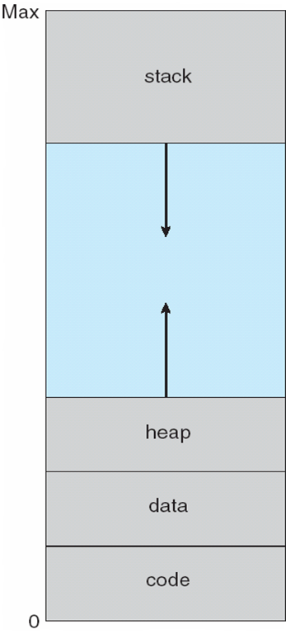
Virtual Address Space
Usually design logical address space for stack to start at maximum logical address and grow “down” while heap grows “up”
Maximizes address space use
Unused address space between the two is hole
No physical memory needed until heap or stack grows to a given new page
Using sparse address spaces with holes allows growth, e.g. dynamically linked libraries
System libraries can be shared among processes via mapping into virtual address space
Shared memory can be mapped into individual processes’ virtual address space
Pages can be shared during fork(), thus speeding process creation

Slide 6
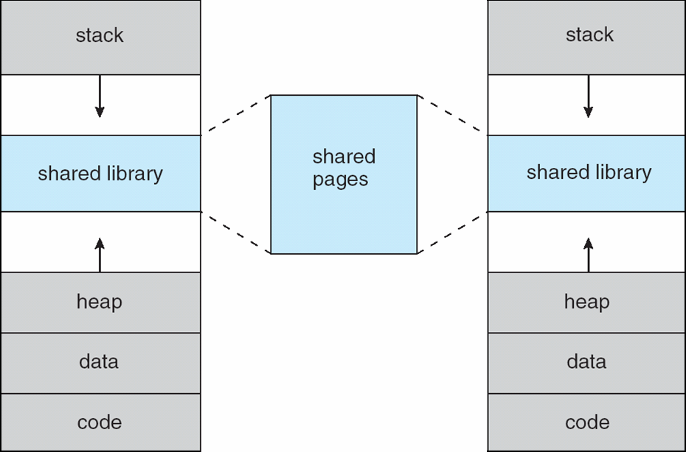
Shared Library Using Virtual Memory

Slide 7
Demand Paging
Instead of bringing a process’ entire address space into memory, bring a page into it only when it is needed
Less I/O needed, no unnecessary I/O
Less memory needed
Faster response
More users
Page is needed means a reference is made to it
If reference is invalid, then abort
If page of referenced page is not-in-memory, bring to memory
Component that brings a page into memory is a pager

Slide 8
Basic Concepts of Demand Paging
How to determine the set of pages to bring in?
Need new MMU functionality to implement demand paging
If pages needed are already memory resident
No difference from non demand-paging
If page needed is not memory resident
Need to locate and load the page into memory from storage
Without changing program behavior
Without programmer needing to change code

Slide 9
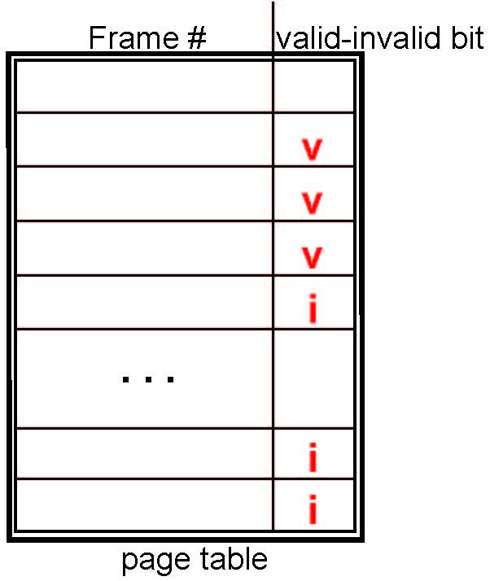
Page Table and Valid-Invalid Bit
Example of a page table snapshot:
Need a page table to keep track of memory allocation of each page
With each page table entry a valid–invalid bit is associated (v ⇒ in-memory (memory resident), i ⇒ not-in-memory)
Initially valid–invalid bit is set to i on all entries
During MMU address translation, if valid–invalid bit in page table entry is i ⇒ page fault

Slide 10
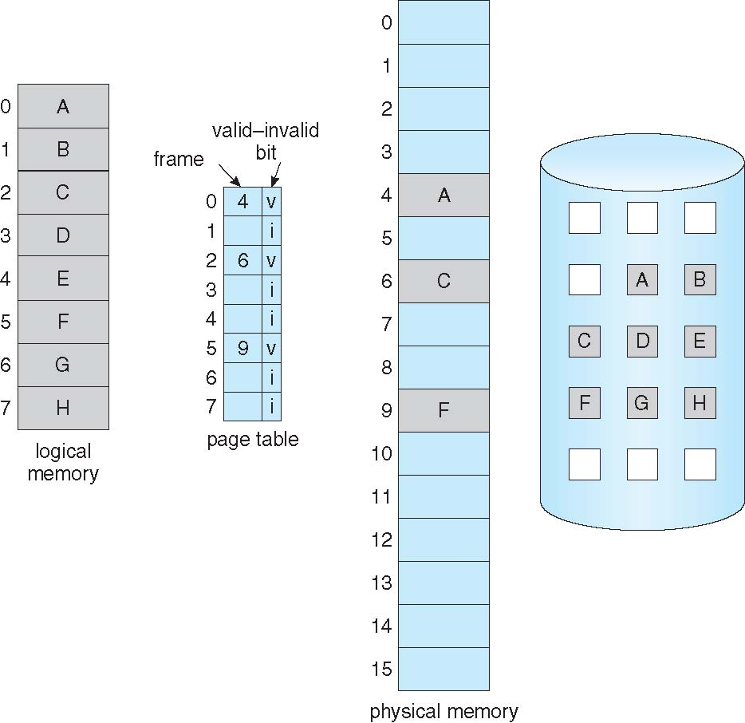
Page Table When Some Pages Are Not in Memory

Slide 11
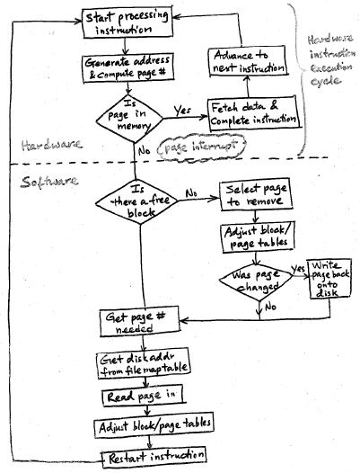
Instruction Execution in a Paging Environment
When page being referenced is not in memory, page fault occurs & need to bring page in
Find a free frame
Swap page into frame via scheduled disk operation
Reset tables to indicate page is now in memory & set valid-invalid bit to “v”
Restart instruction that caused the page fault
If no free frame, need to replace

Slide 12
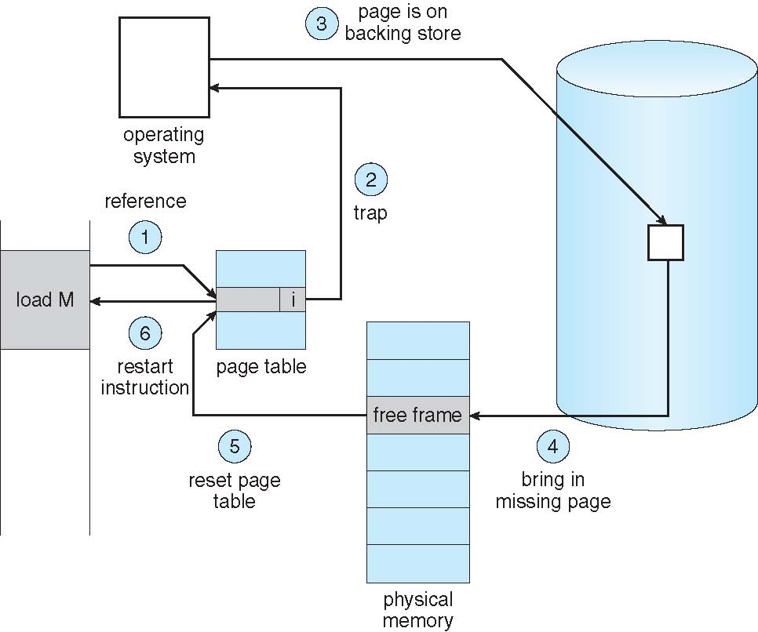
Steps in Handling Page Fault

Slide 13
Performance of Demand Paging
Steps at page fault in Demand Paging (worst case)
Trap to the operating system
Save the user registers and process state
Determine that the interrupt was a page fault
Find a free page frame
Allocate if one is available
Select a page to remove if not, and schedule a write-back if page had been modified
Determine location of the page on disk
Issue a read from the disk to the free frame
Wait in a queue for this device until the read request is serviced
Wait for the device seek and/or latency time
Begin the transfer of the page to a free frame
While waiting, allocate the CPU to some other user process
Receive an interrupt from the disk I/O subsystem (I/O completed)
Save the registers and process state for the other user process
Determine that the interrupt was from the disk
Correct the page table and other tables to show page is now in memory
Wait for the CPU to be allocated to this process again
Restore the user registers, process state, and new page table, and then resume the interrupted instruction

Slide 14
Performance of Demand Paging (cont.)
Three major activities
Service the interrupt – careful coding means just several hundred instructions needed
Read the page – lots of time
Restart the process – again just a small amount of time
Page Fault Rate 0 ≤ p ≤ 1
if p = 0 no page faults
if p = 1, every reference is a fault
Effective Access Time (EAT)
EAT = (1 – p) x memory access
+ p (page fault overhead
+ swap page out
+ swap page in )

Slide 15
Demand Paging Example
Assume
Memory access time = 200 nanoseconds (nsec)
Average page-fault service time = 8 milliseconds (msec)
EAT = (1 – p) x 200 nsec + p (8 msec+200 nsec)
= 200 – p x 200 + p x 200 + p x 8,000,000
= 200 + p x 8,000,000
If one access out of 1,000 causes a page fault, then
EAT = 8,200 nsec = 8.2 microseconds.
This is a slowdown by a factor of 40!!
If want performance degradation < 10 percent
220 > 200 + 8,000,000 x p 20 > 8,000,000 x p
p < .0000025
< one page fault in every 400,000 memory accesses

Slide 16
What Happens If There Is No Free Frame
Page frames may be used up by process pages
Page frames are also in demand from the kernel, I/O buffers, etc
How much to allocate to each process?
Page replacement – find some page in memory, but not really in use, page it out
Reason for finding page replacement, as opposed to swapping out process
Performance consideration – want an algorithm which will result in minimum number of page faults
Same page may be brought into memory several times

Slide 17
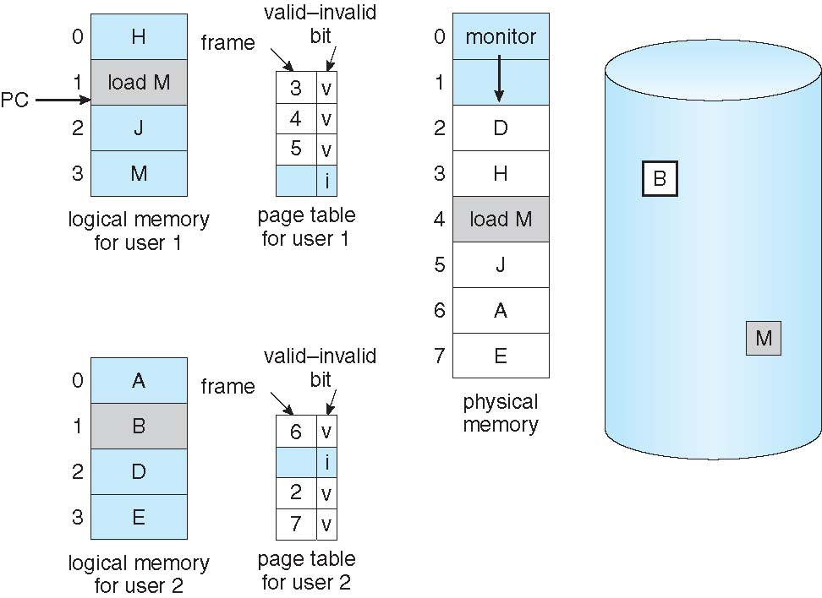
Illustration of Need for Page Replacement

Slide 18
Basic Page Replacement
Find the location of the desired page on disk
Find a free frame: - If there is a free frame, use it - If there is no free frame, use a page replacement algorithm to select a victim frame - Write victim frame to disk if dirty
Bring the desired page into the (newly) free frame; update the page and frame tables
Continue the process by restarting the instruction that caused the trap
Note now potentially 2 page transfers for page fault – increasing EAT

Slide 19
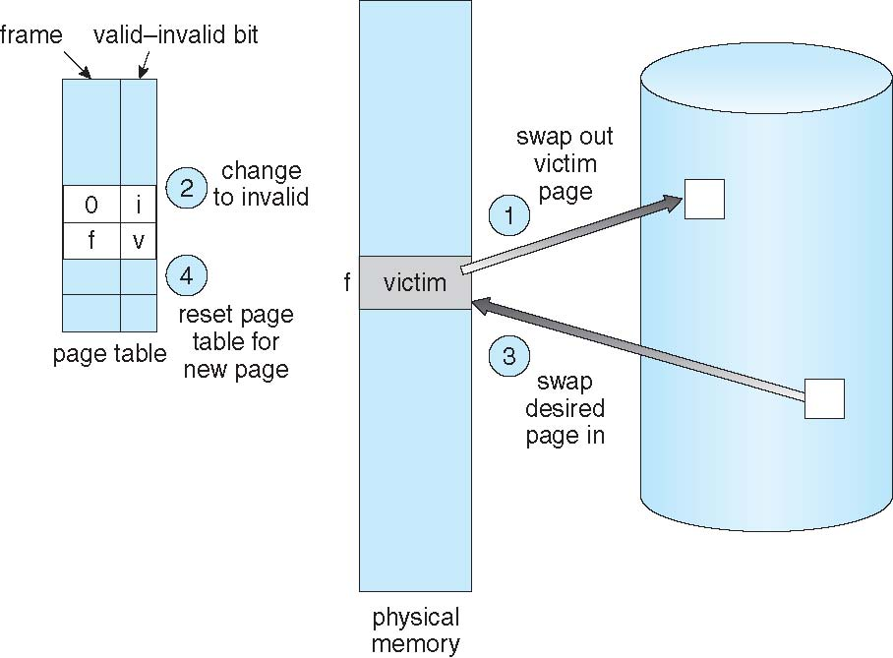
Page Replacement

Slide 20
Frame Allocation & Page Replacement
Frame-allocation algorithm determines
How many frames to give each process
Which frames to replace
Page-replacement algorithm
Want lowest page-fault rate on both first access and re-access
Evaluate algorithm by running it on a particular string of memory references (reference string) and computing the number of page faults on that string
String is just page numbers, not full addresses
Repeated access to the same page does not cause a page fault
Results depend on number of frames available
In all our examples, the reference string of referenced page numbers is
7,0,1,2,0,3,0,4,2,3,0,3,0,3,2,1,2,0,1,7,0,1

Slide 21
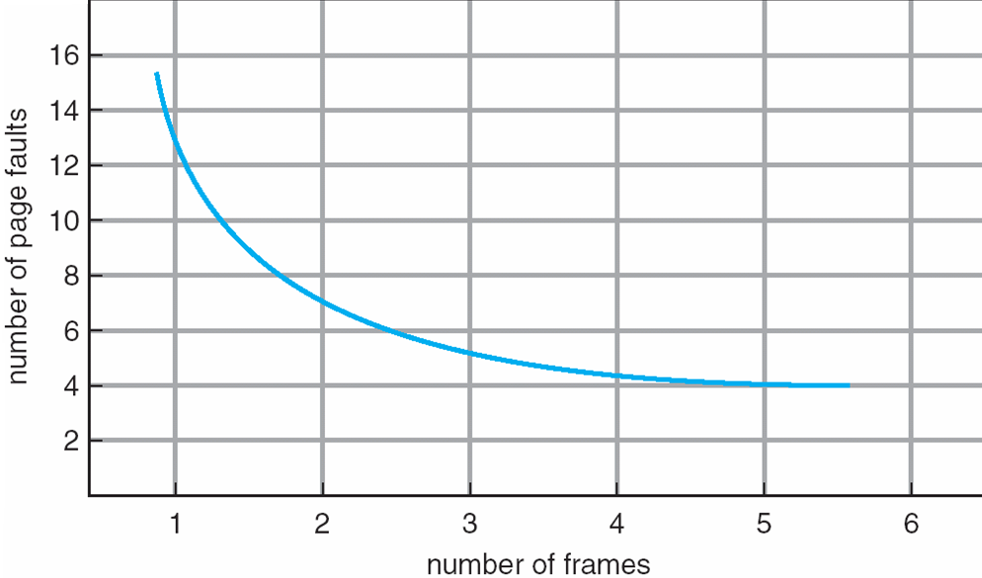
Expected Graph of Page Faults vs. Number of Frames

Slide 22
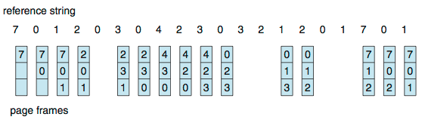
First-In-First-Out (FIFO) Algorithm
Reference string: 7,0,1,2,0,3,0,4,2,3,0,3,0,3,2,1,2,0,1,7,0,1
3 frames (3 pages can be in memory at a time per process)
15 page faults
Consider another string: 1,2,3,4,1,2,5,1,2,3,4,5
Adding more frames can cause more page faults!
Belady’s Anomaly
How to track ages of pages?
Just use a FIFO queue

Slide 23
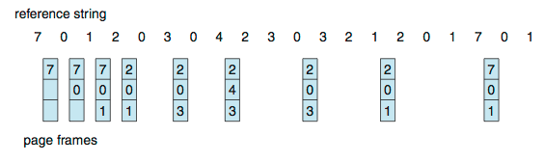
Optimal Algorithm
Replace page that will not be used for longest period of time
9 is optimal for the example
Difficult to implement since we can’t read the future
Useful for measuring how well your algorithm performs

Slide 24
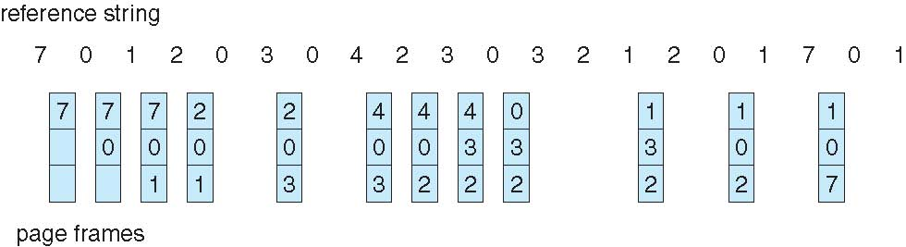
Least Recently Used (LRU) Algorithm
Use past knowledge rather than future
Replace page that has not been used in the most amount of time
Associate time of last use with each page
12 faults – better than FIFO but worse than OPT
Generally good algorithm and frequently used
But how to implement?

Slide 25
LRU Algorithm (cont.)
Counter implementation
Every page entry has a counter; every time page is referenced through this entry, copy the clock into the counter
When a page needs to be changed, look at the counters to find smallest value
Need to search through table
Stack implementation
Keep a stack of page numbers in a double link form:
Page referenced:
Move it to the top
Requires 6 pointers to be changed
No search for replacement
But each update more expensive
LRU and OPT are cases of stack algorithms that don’t have Belady’s Anomaly

Slide 26
Use Stack to Record Page Reference History

Slide 27
LRU Approximation Algorithms
LRU needs special hardware and still slow
Basis of approximate algorithms: Reference bit
With each page associate a bit, initially = 0
When page is referenced bit set to 1
Replace a page with reference bit = 0 (if one exists)
Second-chance algorithm
Generally FIFO, plus hardware-provided reference bit
Clock replacement
If page selected has
Reference bit = 0 then replace it
Reference bit = 1 then:
set reference bit 0, leave page in memory
Move to next page, subject to the same rules

Slide 28
Second-Chance (Clock) Page Replacement Algorithm

Slide 29
Counting Algorithms
Keep a counter of the number of references that have been made to each page
Not common
Lease Frequently Used (LFU) Algorithm: replaces page with smallest count
Most Frequently Used (MFU) Algorithm: based on the argument that the page with the smallest count was probably just brought in and has yet to be used

Slide 30
Thrashing
If a process does not have enough frames to hold pages in active use, the page-fault rate can be very high
Page fault to get page
Replace a resident page to free a frame
But the replaced page is needed again soon
This leads to:
Low CPU utilization
Operating system thinking that it needs to increase the degree of multiprogramming
Another process added to the system
Thrashing ≡ a process is spending more time swapping pages in and out than running
Solution: working set model

Slide 31
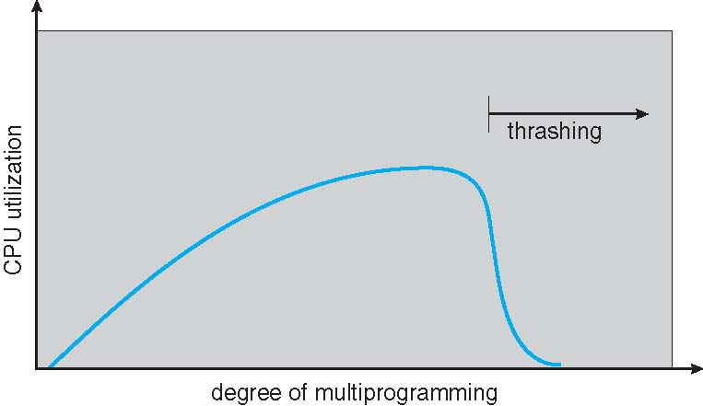
Thrashing

